Slide 1
ABAP-Managed Database Procedures(AMDP)

Slide 2
What is AMDP
AMDP stands for ABAP-Managed Database Procedures
AMDP is a new feature in ABAP allowing developers to write database
procedures directly in ABAP.
Database Procedure is a function stored and executed in the database.
The implementation language differs from one database system to another.
In SAP HANA it is SQL Script.
Using AMDP allows developers to execute and create database procedures in the ABAP using ABAP data types and ABAP methods.
AMDP is specifically for HANA Database.or container of business objects, T-code for BOR (Business Object Repository) is SWO1.

Slide 3
The basic concept of AMDP is to control HANA procedures and their lifecycle withinside the ABAP server.
To permit native consumption of HANA features from within the ABAP layer, the HANA database manner language SQL Script has been incorporated into the ABAP stack.
AMDP is applied in ABAP class methods (so-called AMDP methods) that function as a container for SQL Script code.
This method permits the shipment of AMDP in the same manner as another ABAP development object (lifecycle management)

Slide 4
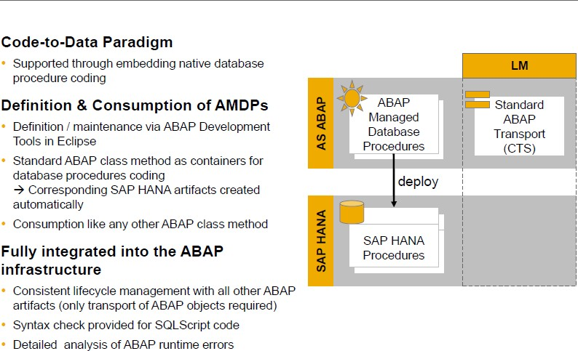
AMDP

Slide 5
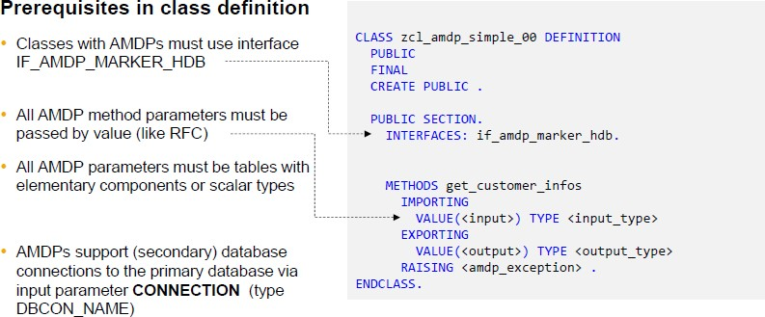
AMDP

Slide 6
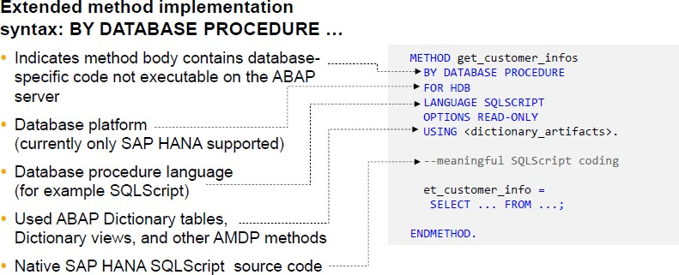
AMDP

Slide 7
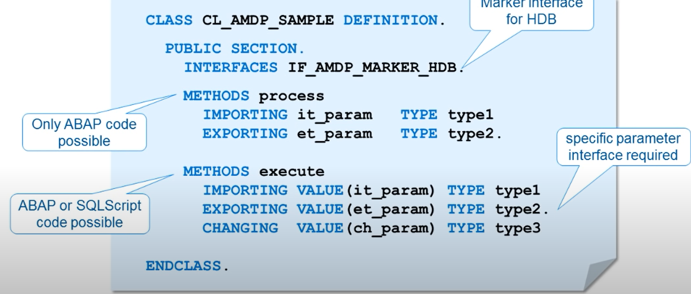

Slide 8
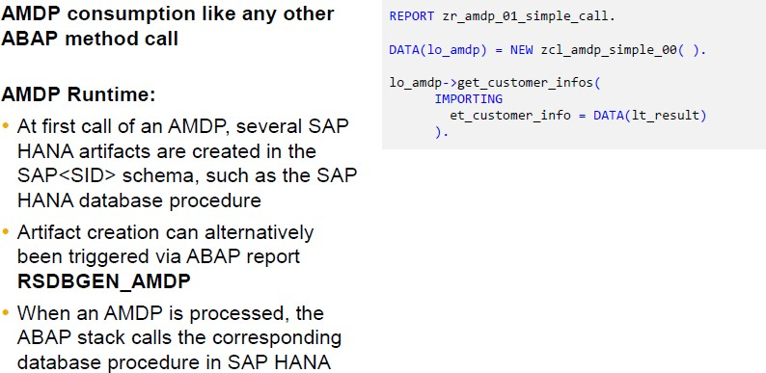
AMDP
AMDP
AMDP consumption like any other ABAP method call
AMDP Runtime:
At first call of an AMDP, several SAP HANA artifacts are created in the SAP<SID> schema, such as the SAP HANA database procedure
Artifact creation can alternatively been triggered via ABAP report RSDBGEN_AMDP.
When an AMDP is processed, the ABAP stack calls the corresponding database procedure in SAP HANA

Slide 9
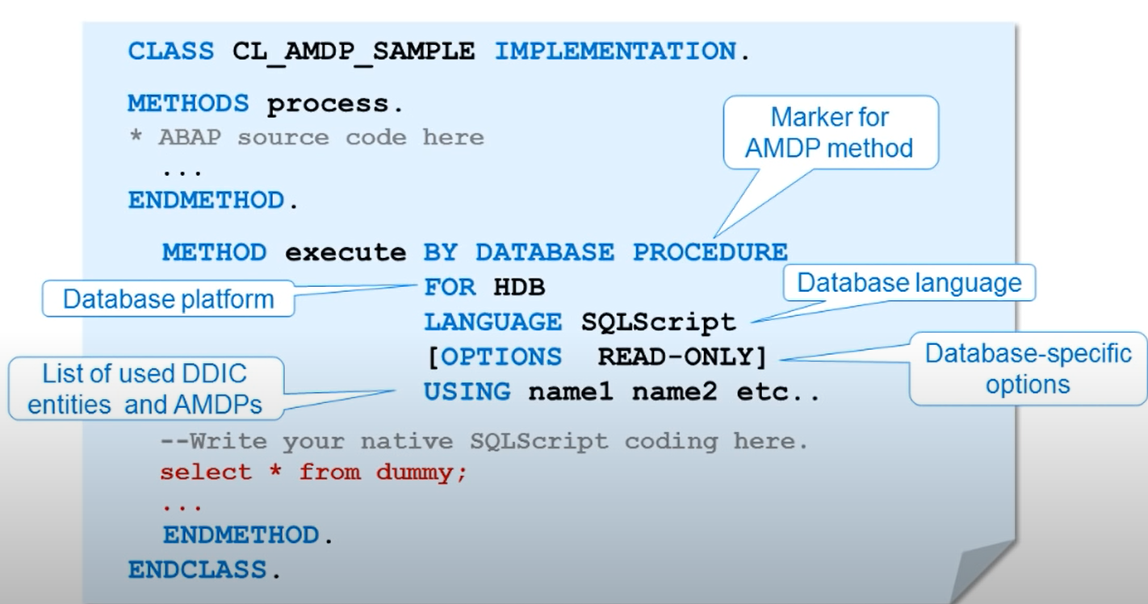

Slide 10
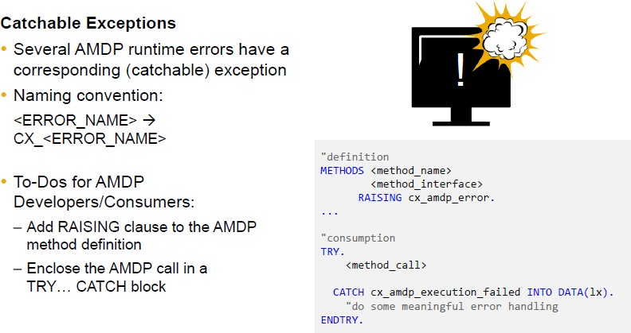
AMDP

Slide 11
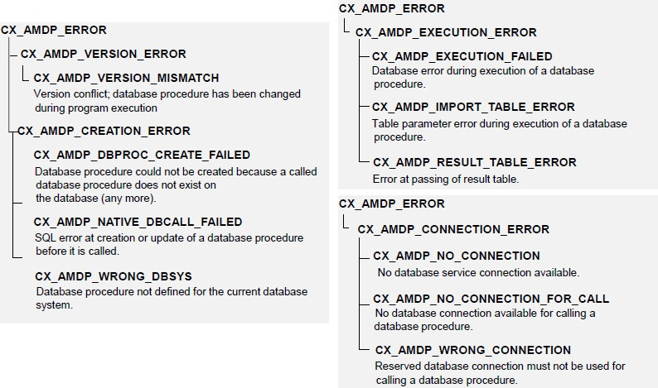
AMDP
Structure of AMDP Exception Classes

Slide 12

AMDP De
For AMDP Debugging, we need 3 users.
ABAP Developer User ,Who will run the report program
HANA User of same system
Debug user is a HANA User who will set the debugging

Slide 13
AMDP Debugging
Set a break point by Debug User in Catalog DB Procedure
Create debug configuration with Filter criteria
Start SQL script debugger ( Attach session of HANA User )
Developer now execute the ABAP report and AMDP called

Slide 14
AMDP Debugging
Set a break point by Debug User in Catalog DB Procedure
Go to HANA Development perspective with Debug user.
Open SAP developer User schema
Open the respective AMDP HANA Procedure

Slide 15
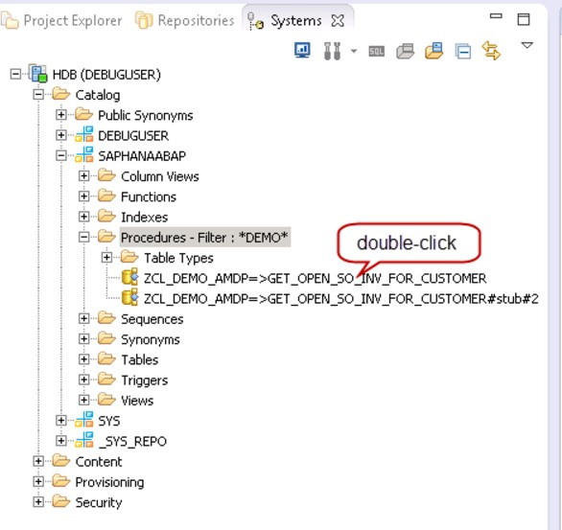
AMDP Debugging

Slide 16
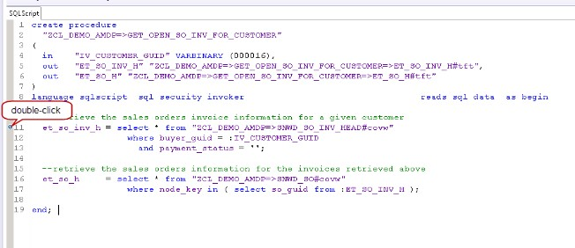
AMDP Debugging
Set a break point by Debug User in Catalog DB Procedure
Set a break point by double click on the left section of the line

Slide 17
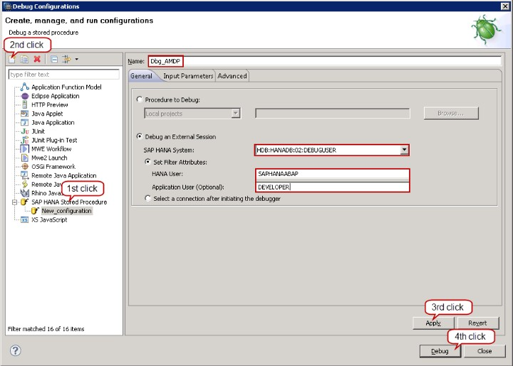
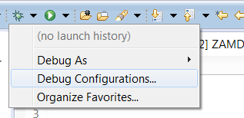

AMDP Debugging
Create debug configuration with Filter criteria
Start SQL script debugger ( Attach session of HANA User)

Slide 18
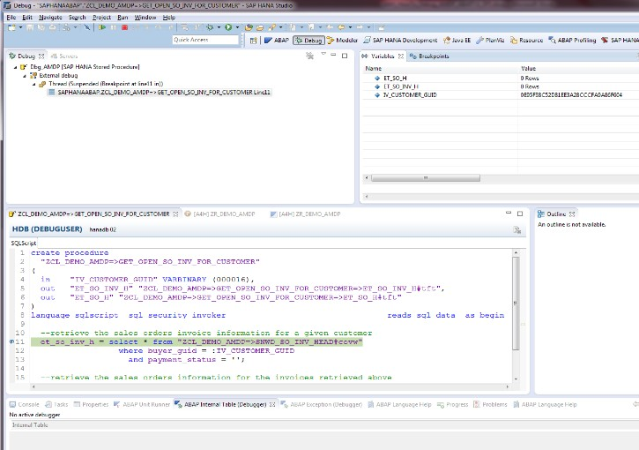
AMDP Debugging
Execute the report by Developer user

Slide 19
AMDP Debugging
Required Authorizations - SAP note 1942471
For the HANA Debug User, the authorization to read the catalogue needs to be granted by the SYSTEM user:
grant catalog read to <DEBUG USER>;

Slide 20
AMDP Debugging
The corresponding grant statements to be executed in the SQL console of the SAP HANA studio (as SAP<SID> user) for the ABAP Managed DB procedure <AMDP_NAME> are:
grant debug on <HANA USER>. “<AMDP_NAME>” to <DEBUG USER> ;
grant execute on <HANA USER>. “< AMDP_NAME>” to <DEBUG USER>;
grant attach debugger to <DEBUG USER>;

